Slide 1
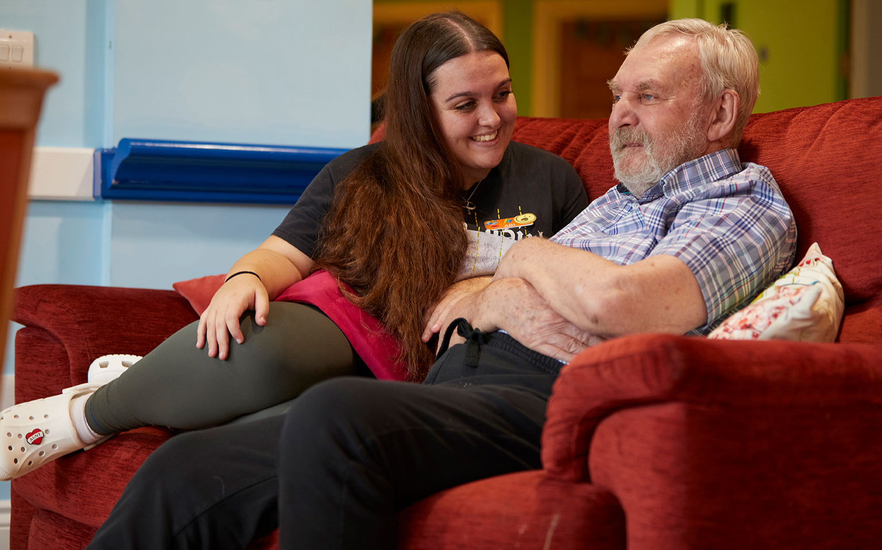
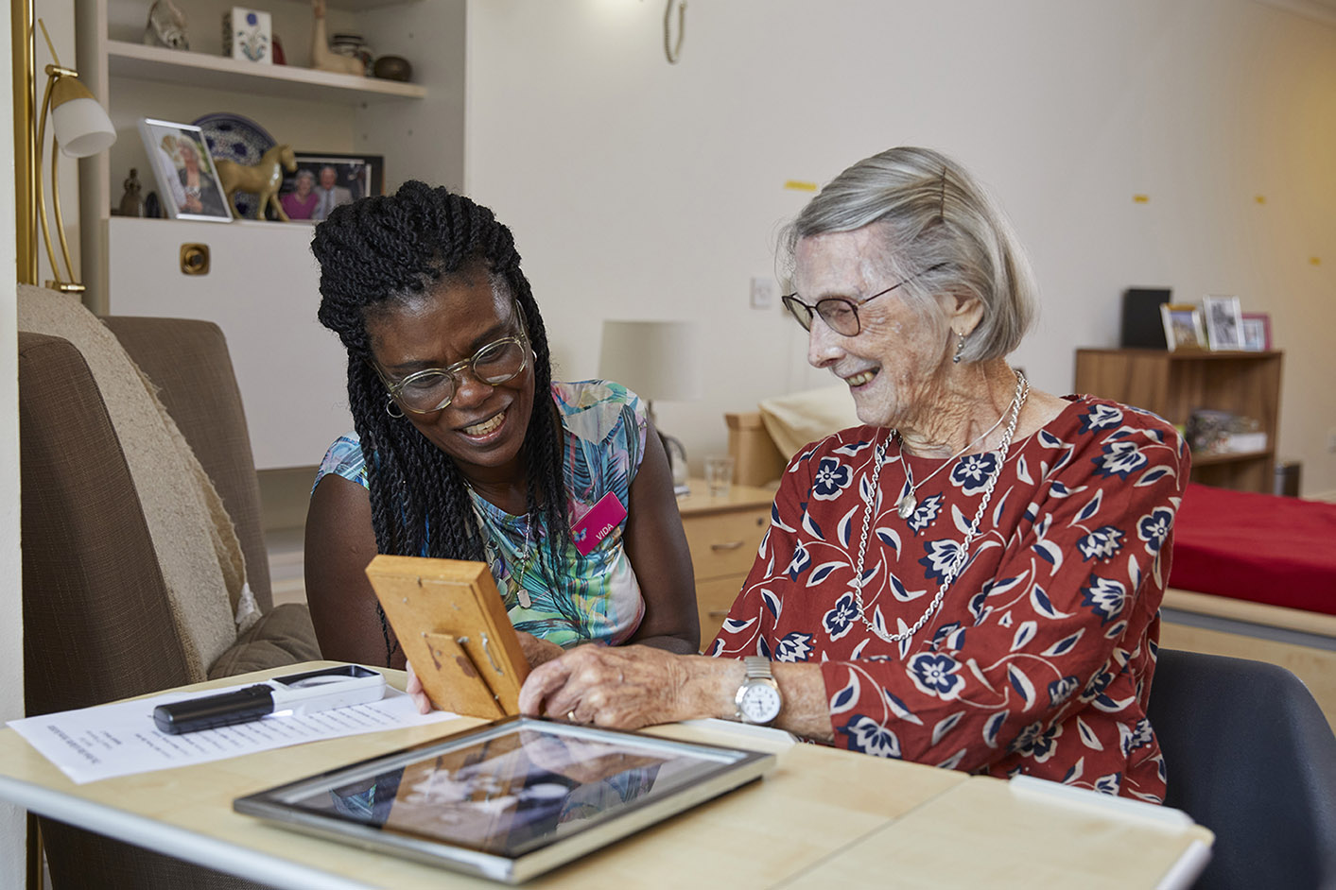
Legacy Manager
Candidate information pack

Slide 2
Welcome to Royal Star & Garter
The role at a glance
Title: Legacy Manager
Location: Hybrid working with a minimum of one day per week in our Hampton Office
Reports to: Director of Supporter Engagement
Hours: 35 hours per week – we will consider requests for part time working
Salary: £48k -50k FTA, depending on experience.
Closing date: Monday 8th July 24
We have the privilege of ensuring that the veterans and their partners we care for and support can lead happy and fulfilled lives. We currently run three Homes and have also launched new services reaching out into the community. Our care staff are nothing short of exceptional, while colleagues in Central Services provide unrivalled support.
We are looking for an experienced Legacy Manager to lead a small but high performing team generating significant fundraising revenue from legacies and in-mem giving. You must be able to demonstrate a high level of knowledge of legacy case management, be able to deal with a wide range of stakeholders and have experience of successful marketing to generate a long-term pipeline of potential income. You will need to work closely with colleagues across the Fundraising and Marketing department and be able to both lead and participate in relevant planning and strategy development.
We are looking for someone who shares our values and is confident in their field of work. Hybrid working is in place and so your ability to operate independently to achieve agreed outcomes, and to manage others in doing the same, is also key. We would expect this person to hold an appropriate qualification and to have a high knowledge of will, probate and tax laws. They should also be supporter centric with the understanding and ability to deliver a first-class customer experience to the range of people involved in the legacy journey. If this is you, then we look forward to receiving your application.
Thank you for your interest.
Caley Eldred
Director of Supporter Engagement

Slide 3
Job description
To raise annual income targets through the management, development and administration of legacies and In Mem giving with a focus on delivering effective strategies that maximise all potential income
To lead a highly effective legacy management service working with stakeholders, both internal and external, at a variety of levels
To oversee the planning and delivery of an effective marketing and communications schedule that supports the acquisition of new pledgers to support the long-term development of our legacy pipeline
To provide excellent levels of supporter care to legacy pledgers and in memory donors, demonstrating the importance and impact of their gifts.
Purpose
Strategy
To develop and deliver cultivation strategies that drive the retention and growth of legacy pledgers with a focus on generating gifts from the existing supporter base and new audiences
To oversee the planning and delivery of a comprehensive schedule of marketing and communication that incorporates both digital and print activity with a focus on cold recruitment, making use of our free will offers
To ensure there is an appropriate journey in place for our In Mem donors to include the introduction of Tribute Funds
To manage large income and expenditure budgets and to update effective tools that enable robust annual projections in line with our annual planning cycle.
Management
To provide effective line management, including personal development, to the Legacy Marketing Assistant and Legacy & In Mem Assistant Administrator ensuring they deliver in line with identified annual objectives
To manage a work stream to the Legacy Case Administration Specialist, ensuring relevant cases are referred and the weekly log is maintained for consistency of service
To work effectively with the Marcomms team to evaluate and review relevant elements of the legacy marketing schedule.
Key responsibilities

Slide 4
Job description - continued
Administration and process
Oversee estate accounts and the legacy caseload, ensuring appropriate levels of checks and risk to optimise the value of all bequests, working within delegated authority
To ensure comprehensive procedures are in place for the management of legacies and in mem giving
To maintain and support accurate record keeping in all aspects fully utilising the functions of First Class and the fundraising CRM.
Other
To play a key role in the delivery of the overall fundraising strategy, leading, enabling & encouraging cross-team working
To be a brand ambassador encouraging a deep understanding of the values, ensuring consistency externally to a range of audiences
To adhere to data protection legislation and to be fully conversant with relevant legislation (Trustee Act 2000) and the guidelines of the Fundraising Regulator and the GDPR and promote where necessary.
To undertake other such duties as may be required and which are consistent with the nature of this role.
To apply
Send your CV and a covering letter (no more than two sides) outlining how you meet the person specification and what you will bring to the role to ajla.dizdarevic@starandgarter.org
Key responsibilities

Slide 5
Person specification
Knowledge and experience:
Significant experience of managing legacy and in memory giving with the ability to oversee complex case management
Knowledge of will, probate and tax law
ILM certificate in charity legacy administration, or appropriate legal qualification
Experience in delivering supporter-centric care
Demonstrable line management experience
Experience of devising, implementing and leading on strategic projects including KPIs, budgets and reports
Ability to devise and implement effective marketing strategies both on and off line, ensuring appropriate data management use of CRM
Experience of working in a busy fundraising environment with the ability to plan, prioritise and manage a varied workload and
Good knowledge of relevant charitable legislation and guidelines.
Skills:
Excellent communication skills both written and verbal with the ability to manage complex referrals and recommendations relating to estate administration
Excellent relationship building working with senior individuals
The ability to work across teams and get the best from line reports through effective direction, support and listening
Good IT skills including Word, Excel, PowerPoint, First Class and those related to communicating online (email & social media channels).

Slide 6
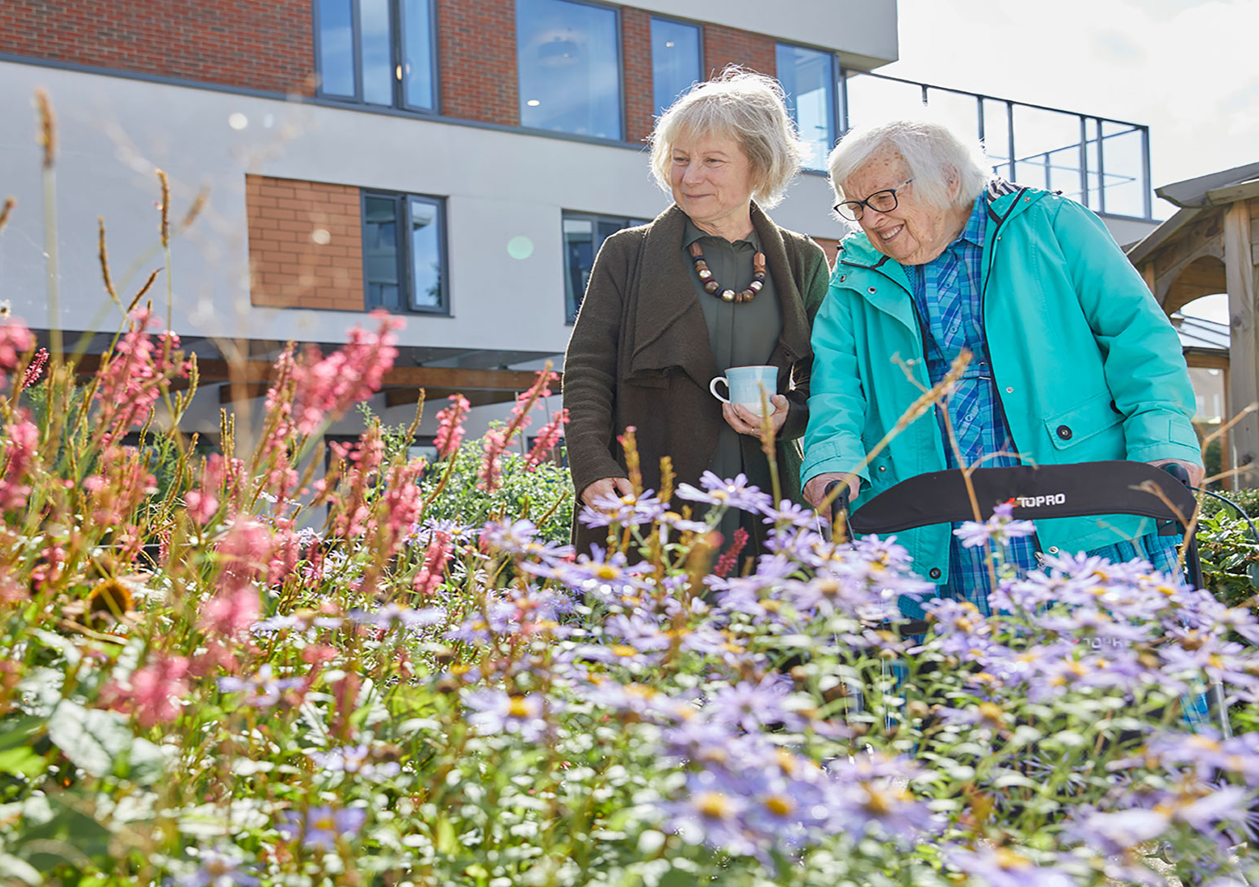
Person specification - continued
Personal characteristics should include:
A self-starter with energy, who motivates with enthusiasm
Sets high performance standards for oneself and others
Reliable, professional manner; flexible and calm under pressure
We reserve the right to update and amend this job description to ensure it accurately reflects the role.
This will be agreed in consultation with the job holder.

Slide 7
Conditions of employment
Any offer of employment made will be subject to the following conditions:
Satisfactory references covering the last five years including one from your current or most recent employer
A pre-employment medical questionnaire
Enhanced DBS Disclosure
Proof of the Right to Work in the UK.

Slide 8
With love
Living positively
Our values
We carry out our work with love, care and compassion.
We are optimistic in everything we do, supporting veterans and their partners in leading happy, fulfilled lives.
As a family
Standing in their shoes
Take courage
We work and live as one team, one family, one community.
We show admiration and respect for people and never forget what they have done.
We are not afraid to do what is right and what is needed.

Slide 9
Offer
Although we are a charity we offer a generous package
Two months full occupational sick pay, one month half pay before statutory sick pay
Access to appropriate professional bodies and payment of relevant membership fees after six months of employment
Learning and development – opportunities to support you in your role
Salary of £50,000
35 hours per week
25 days holiday per annum plus bank holidays
Employer Pension Contribution of 7.5% with matching Employee contribution of 5%
Life insurance of 3 x salary (until age 70)

Slide 10
About us
Our vision and mission
Vision: A future where all veterans can live life to the full.
Mission: To provide an outstanding range of quality care and therapies to veterans and their partners living with disability or dementia.
Our care
We provide loving, compassionate care to veterans and their partners who live with disability or dementia. Our Homes in Solihull, Surbiton and High Wycombe offer specialist residential long and short break care. In addition we are developing a range of services to help us reach the wider military community including Lunch Clubs, Day Care and a Telephone Friendship Service.

